Slide 1
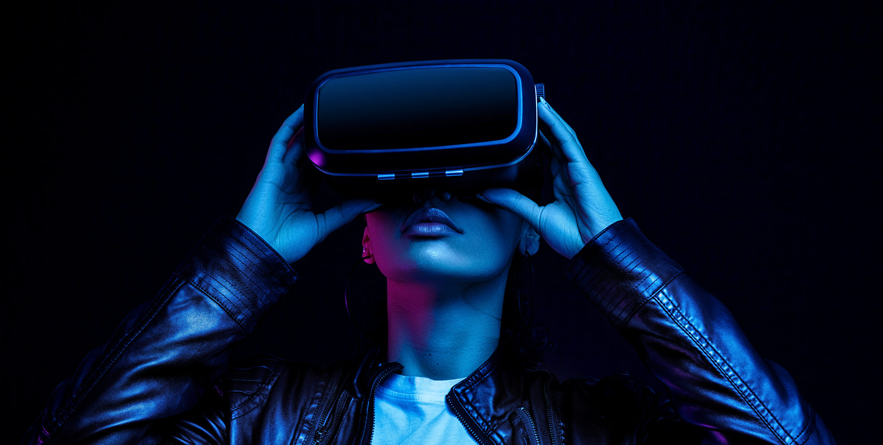
Explore the possibilities of VR-NUI
All reality is virtual…

Slide 2
Definition
The virtual reality is the computer interactive simulation from the point of view of the participant, in which the sensory information he/she perceives is substitututed or augmented.
A.Rowell

Slide 3













Aplications of Virtual Reality
Military
Healthcare
Fashion
Business
Sport
Scientific
Visualization
Construction
Programming
Education
Entertainment
Engineering
Media
Telecommunications

Slide 4
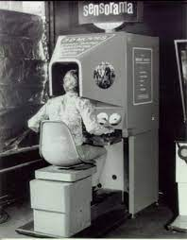
History
In 1950 visionary Morton Heilig built a single user console called Sensorama. This enabled the user watch TV in 3 dimensional way.

Slide 5
Types of Virtual Reality
Immersive Virtual Reality
Non-Immersive Virtual Reality
Window on World Virtual Reality

Slide 6
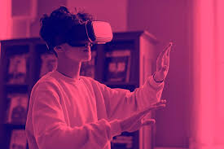
Immersive Virtual reality
Immersion into virtual reality is a perception of being physically present in a non-physical world.
Elements of virtual environments that increase the immersivness of the experience:
Continuity of surroundings
Conformance of human vision
Freedom of movement
Physical interaction
Physical feedback

Slide 7
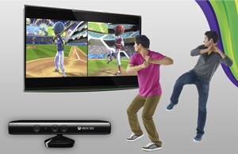
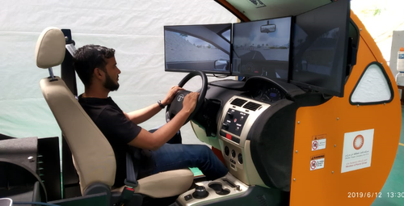
Non-Immersive Virtual Reality
Large display, but doesn`t surround the user.

Slide 8
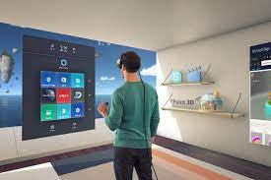
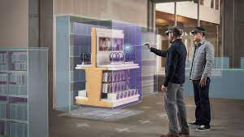
Window on World Virtual Reality
Desktop-based Virtual Reality involves displaying a 3-dimmensional virtual on regular desktop display without using any specialized movement tracking environment.

Slide 9
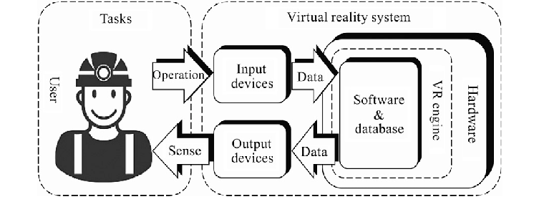
How VR System works

Slide 10
VR Hardware
Input devices
Output devices

Slide 11
Input Devices
Trackers
Sensing Gloves
Haptic feedback systems
Kinect
Voice Recognation
Brain signal reader
3-6 DOF controllers
Capture
Space balls
You use input devices to communicate your intentions and actions to the virtual world.
These devices collect data about user movements and positions- turn of the head, the wave of a hand, movements of the eyes.

Slide 12
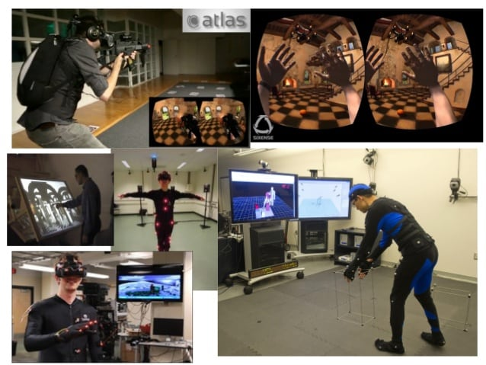
1. VR Trackers
The tracking input system are sensors that are in charge of capturing the position and orientation of a real object.

Slide 13
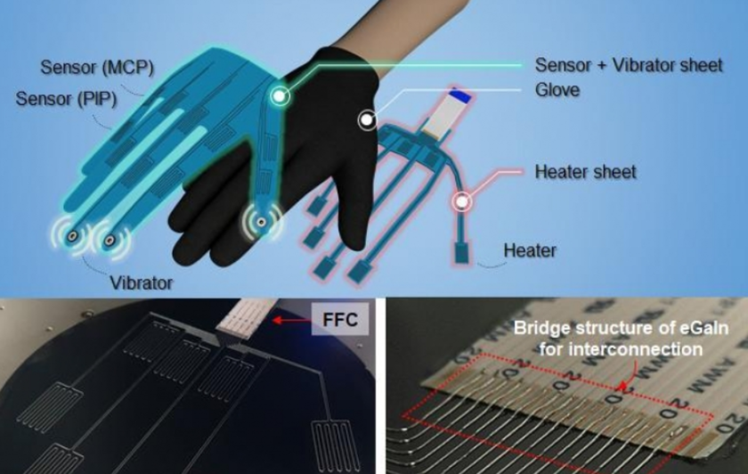
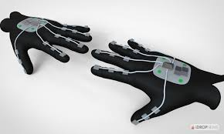
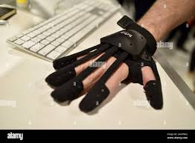
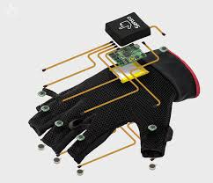
2. VR Sensing Gloves

Slide 14
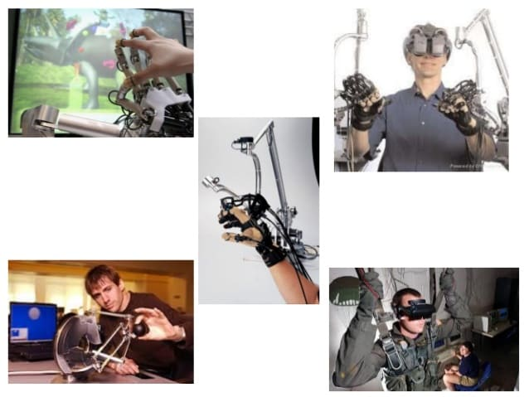
3. VR Haptic Feedback System
From the greek Haptos: touch, palpate.
Sensation caused when the skin recieve a mechanical, electrical, chemical, temperature stimulus.

Slide 15
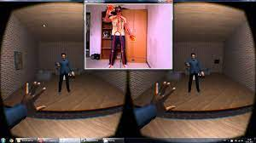
4. VR Kinect

Slide 16
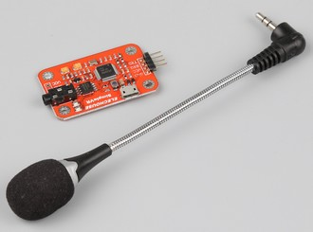
5. VR Voice Recognation

Slide 17
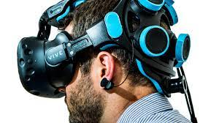
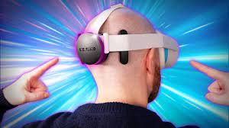
6. VR Brain Signal Reader

Slide 18
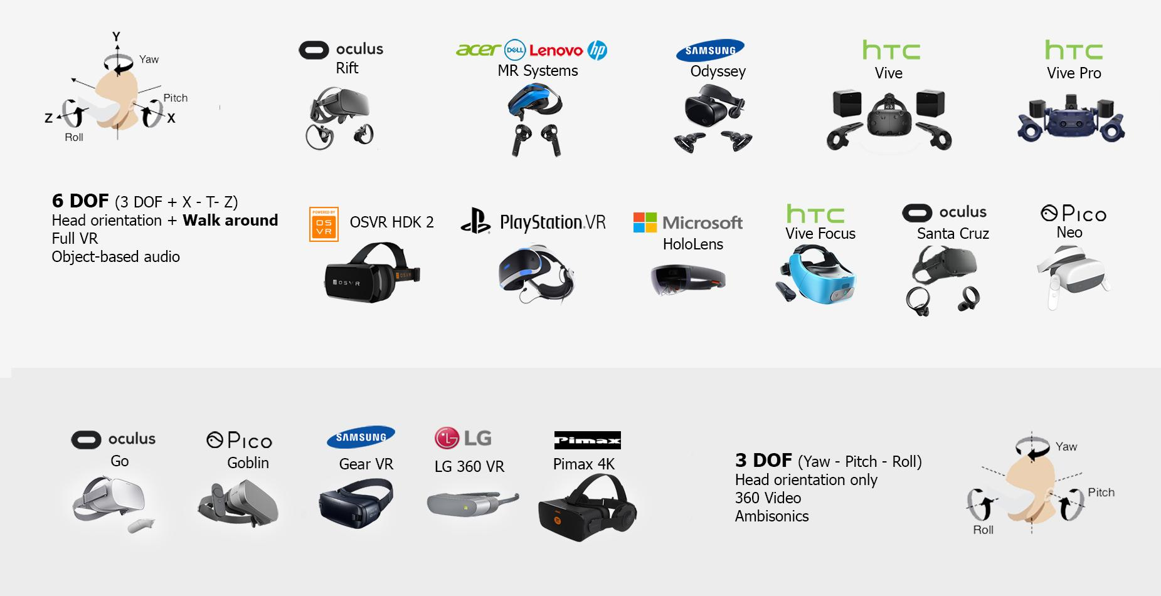
7. 3-6 DoF controllers

Slide 19
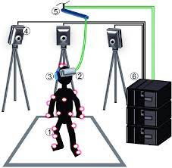
8. VR Capture

Slide 20
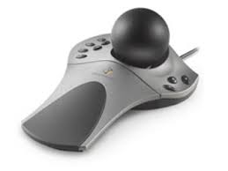
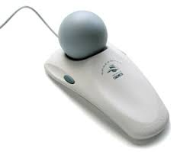
9. VR Space balls

Slide 21
VR Output Devices
Visual devices
Hearing devices
Haptic devices
Olfactory devices

Slide 22
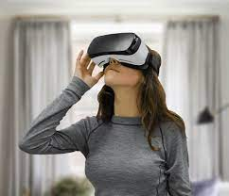
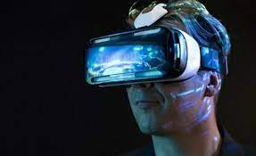
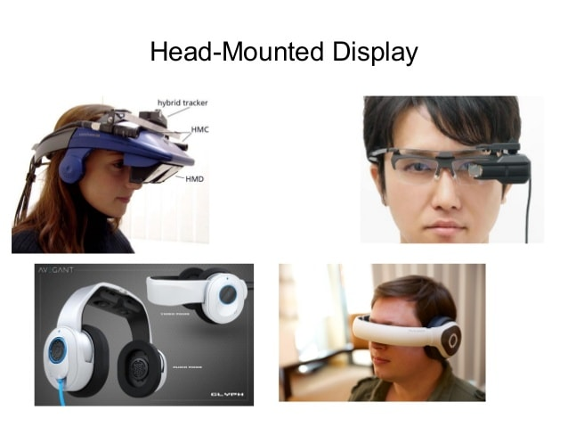
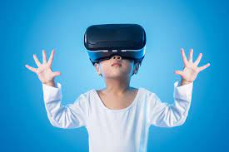
1. VR Output Visual Devices

Slide 23
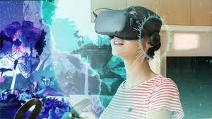
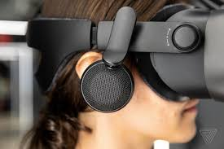
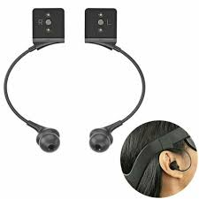
2. VR Output Hearing Devices

Slide 24
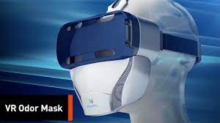
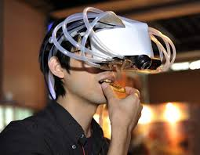
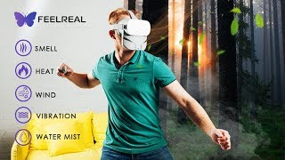
3. VR Output Olfactory Devices

Slide 25
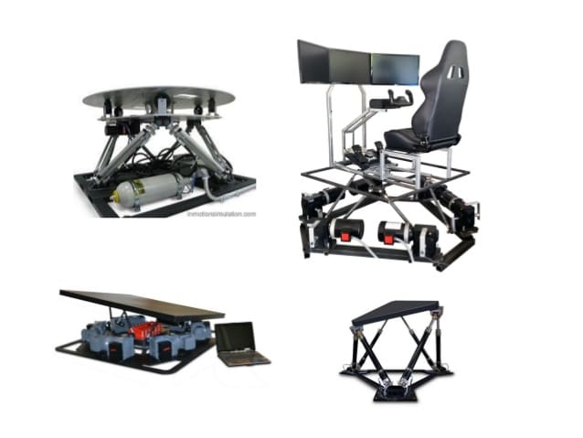
VR Equilibrioception
Equilibrioception or sense of balance it is one of the physiological senses. It allwos humans and animals to walk without falling.
Disrupting the sense of balance causes dizziness, disorientation, and nausea.
(Motion Sickness)

Slide 26
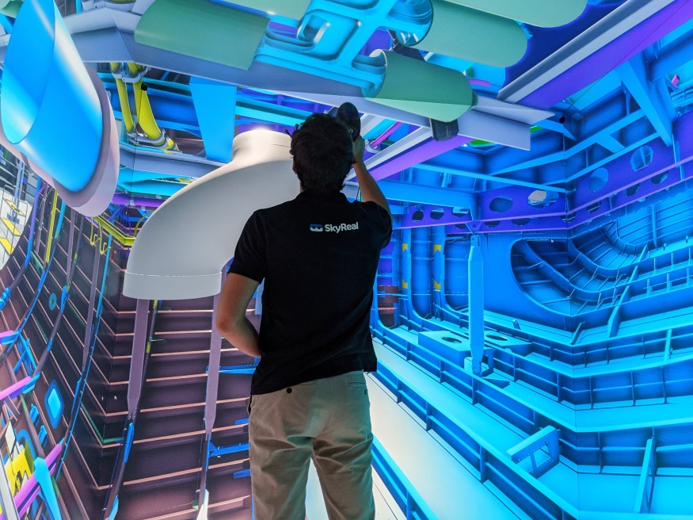
VR Cave
VR Cave is a vr space or cube like room, with 3D images projected on to the walls of the room to create a walk-in immersive 3D environment.

Slide 27
Conclusion
ADVANTAGES
Virtual reality creates a realistic world
It enables user to explore places
Through Virtual Reality user can experiment with an artificial environment
Virtual Reality makes the education more easily and comfort.
DISADVANTAGES
The equipments used in virtual reality are very expensive
It consist of complex technology
In VR environment we can`t move by our own, like in the real world

